Slide 1

Research Project
GAUSSIAN PROCESS FOR STRUCTURAL ANALYSIS AND OPTIMIZATION
Major in Aerospace Structures + Aircraft Design Pathway
Presented by:
Sneha Dwivedi
Under the guidance of:
Prof. J. Morlier & S. Coniglio
24th June, 2019

Slide 2

INTRODUCTION
MESH BASED
MAPPING
Transformation of all data
Physical Domain
Computational Domain
MAPPING
All the calculations performed
Transformation of all data
MESH LESS
All the calculations performed
Very practical to have a geometric definition of your domain.
Physical Domain

Slide 3
MESH FREE METHODS
Generation of nodes
Generating shape functions
Discretization of the equations
Lagrangian method
Direct Interpolation
Essential Boundary conditions
Solution for displacement
Solution for stress and strain

Slide 4
STATE OF ART
1977
SMOOTH PARTICLE HYDRODYNAMICS(SPH) (Lucy)
1992
DIFFUSE ELEMENT METHOD(DEM) (Nayroles et al.)
1994
ELEMENT FREE GALERKIN METHOD(EFG) (Balyschko et al.)
1995
REPRODUCING KERNEL PARTICLE METHOD(RKPM) (Liu et al.)
1996
HP-CLOUDS METHOD (Duarte and Oden)
1977
PARTITION OF UNITY METHOD(PUM) (Babuska and Melenk)
1998
LOCAL BOUNDARY INTEGRAL EQUATION METHOD( Zhu and Zhang)
1998
MESHLESS LOCAL PETROV GALERKIN METHOD( Zhu and Atluri)
2004
MESHLESS NATURAL ELEMENT METHOD(NEM) (Yvonnet)

Slide 5
GAUSSIAN PROCESS
Modeling the function f with multivariate gaussian distribution.
f(x)
f3
f*
f̅(x*) = A(x*; f, l) + Σ Σ B(x*; l) C(x*;f, l)
*Cited from Reference[1]
f2
f1
where:
f̅
approximation of actual function f
x1
x2
x*
x3
x
x*
non sampled point.
A main features(average, mean) of the function f.
B functions(Kernel functions).
C weighting coefficients.
l internal parameters that allow the control of the meta model response.

Slide 6
CASE STUDY ON MOVING NODE APPROACH
Element Free Galerkin (EFG) Method
Meshless local Petrov Galerkin (MLPG) Method
Test functions are the shape functions of moving least squares.
Employs a global weak form of the model.
Lagrange multipliers to enforce boundary conditions.
Employing a local weak form of the model
Recovers test functionals directly from values at nodes, without shape functions.
Numerical integrations to be done over low-degree polynomials

Slide 7
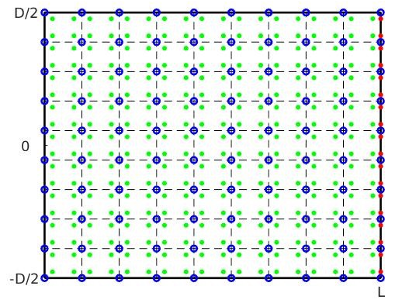
MOVING NODE APPROACH - EFG
Initial results using EFG
Discretization of the domain and boundary of the cantilever beam.*Cited in reference[2]

Slide 8
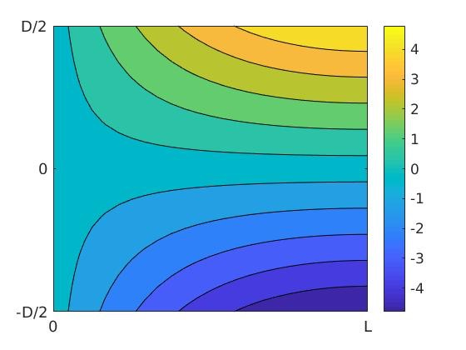
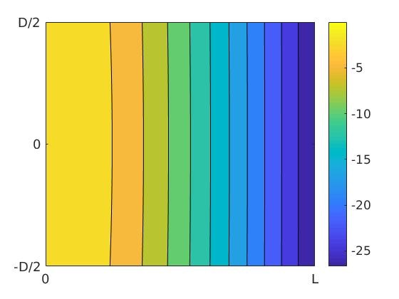
DISPLACEMENT
Displacement obtained in x and y direction respectively.*Cited in reference[2]

Slide 9
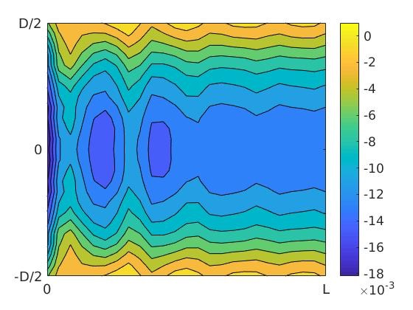
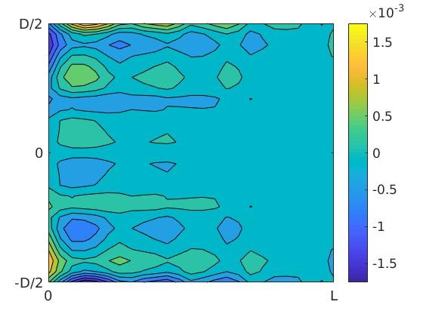
STRESS RESULTS
Shear stress and Normal stress concentration. *Cited in reference[2]

Slide 10
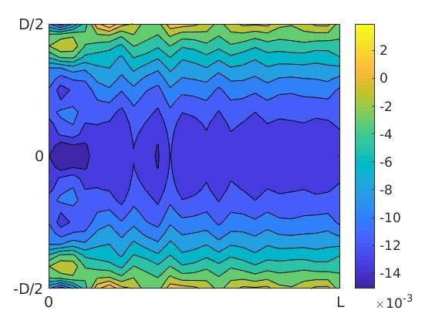
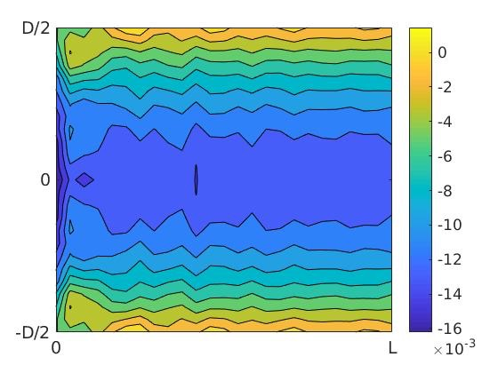
SMOOTHING LENGTH
Fig 1- At 3.5
Fig 2- At 3.0
The approximation of the stress at different smoothing length.

Slide 11
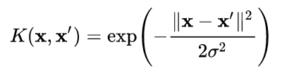
RADIAL BASIS KERNEL FUNCTION
Values depending upon the distance from origin or random point.
ERROR | 0.0976
COMPLIANCE | 2.6888

Slide 12


RADIAL BASIS KERNEL- DISPLACEMENT
Displacement obtained in x and y direction respectively.*Cited in reference[2]

Slide 13
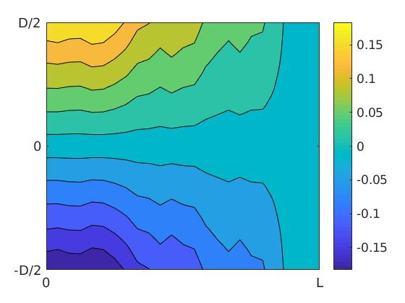
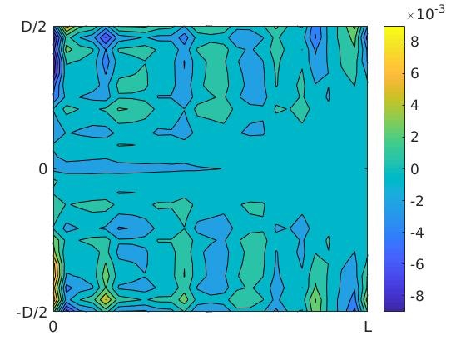
RADIAL BASIS KERNEL- NORMAL STRESS
Normal stress concentration.

Slide 14
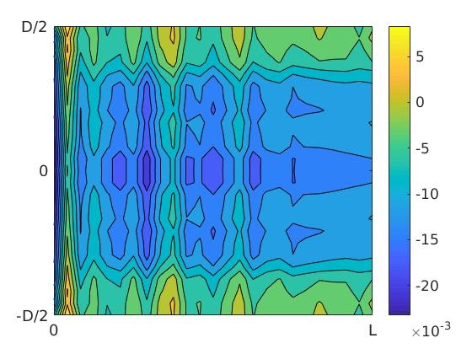
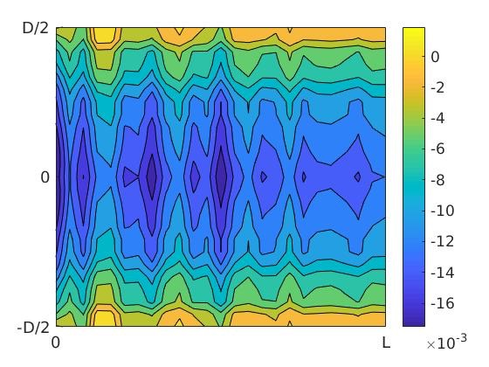
RADIAL BASIS KERNEL- SHEAR STRESS
Fig 1- At n=10
Fig 2- At n=20
The approximation of the stress at different node numbers.

Slide 15
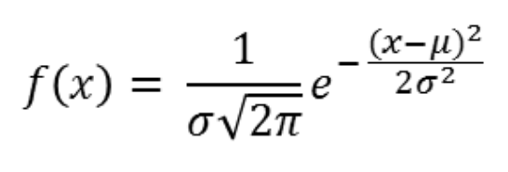
GAUSSIAN KERNEL FUNCTION
A Gaussian kernel is a kernel with the shape of a Gaussian curve. It is a type of Radial Basis kernel.
ERROR | 0.3533
COMPLIANCE | 3.5077

Slide 16
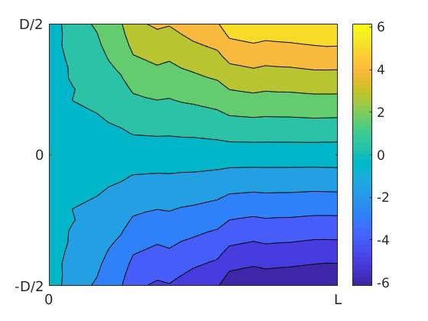
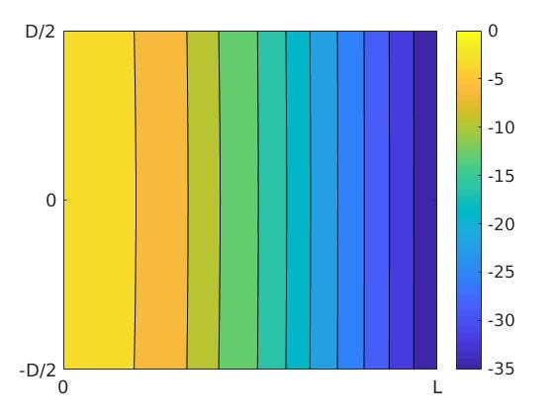
GAUSSIAN KERNEL- DISPLACEMENT
Displacement obtained in x and y direction respectively.

Slide 17
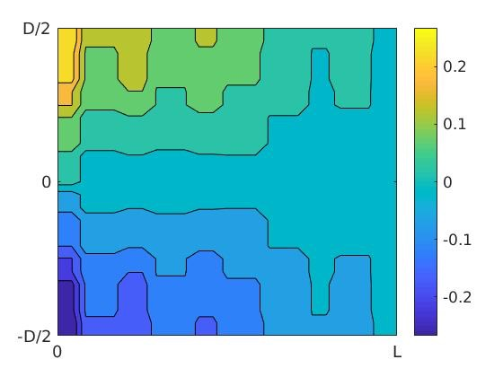
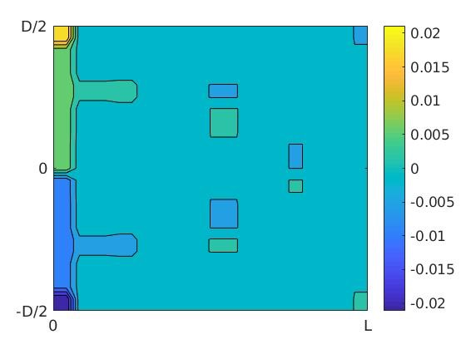
GAUSSIAN KERNEL- NORMAL STRESS
Normal stress concentration.

Slide 18
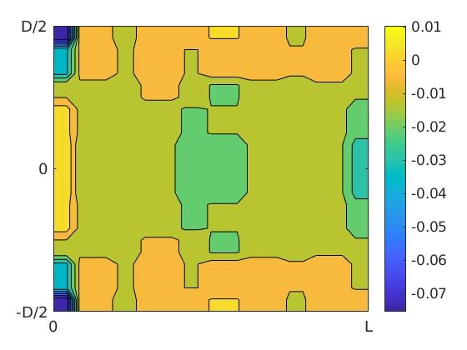
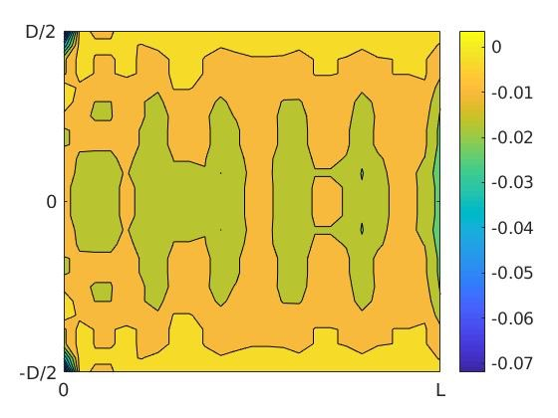
GAUSSIAN KERNEL- SHEAR STRESS
Fig 1- At n=10
Fig 2- At n=20
The approximation of the stress at different node numbers.

Slide 19
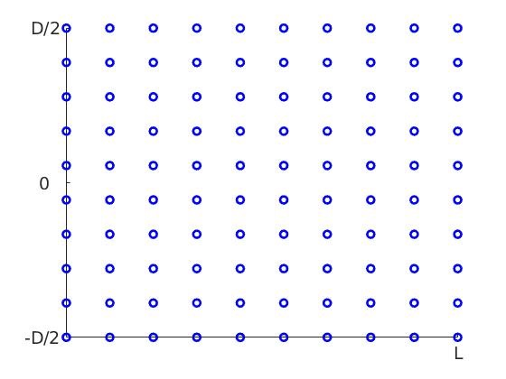
MOVING NODE APPROACH - MLPG
Initial results using MLPG
Discretization of the domain of the cantilever beam. *Cited in reference[2]

Slide 20
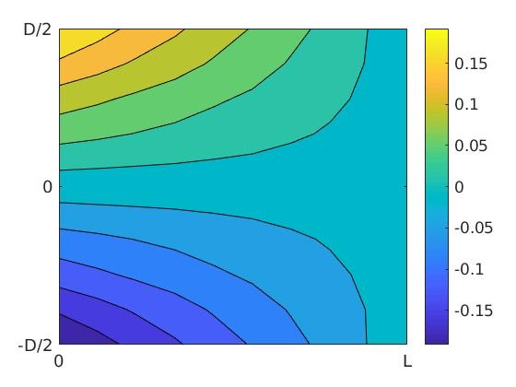
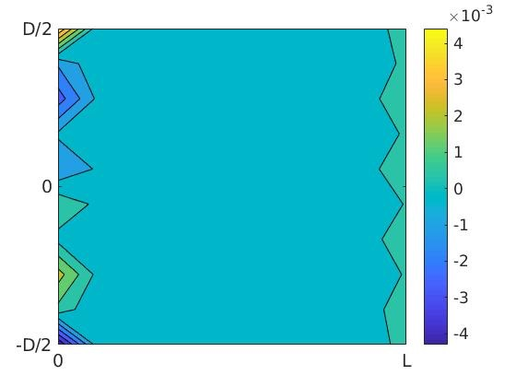
STRESS RESULTS
Normal stress concentration. *Cited in reference[2]

Slide 21
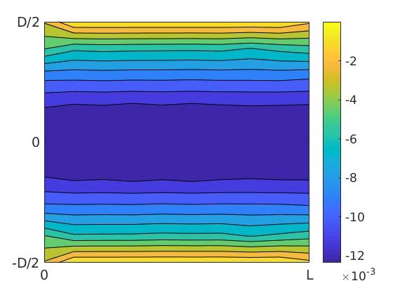
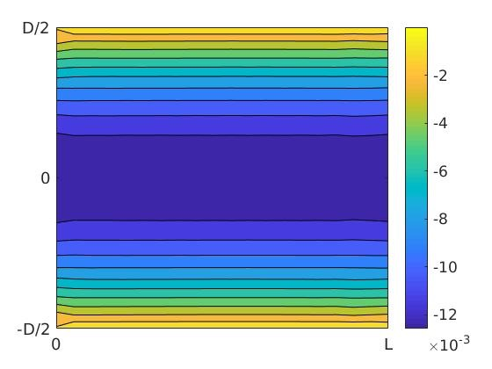
EFFECT OF NODES
Fig 1- At n=10
Error - 0.0483
*Cited in reference[2]
Fig 2- At n=20
Error - 0.0132
The approximation of the stress at different node numbers.

Slide 22
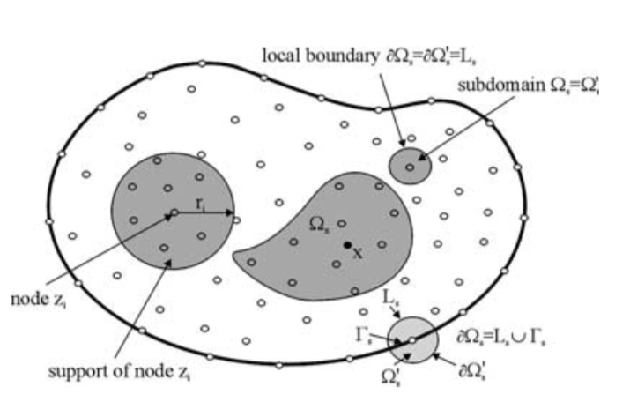
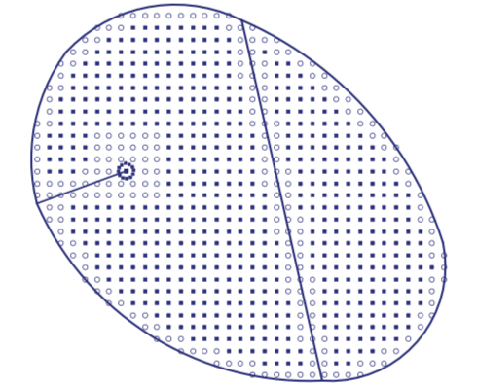
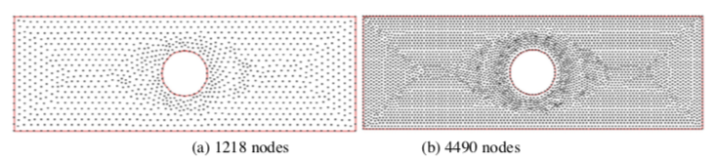
APPLICATIONS
Large deflection of plates *Cited from Reference[5]
Elasticity and fracture problem
*Cited from Reference[4]
Transient heat conduction problem
*Cited from Reference[3]

Slide 23
REFERENCES
Luc Laurent, Rodolphe Le Riche, Bruno Soulier, Pierre-Alain Boucard. “An overview of gradient- enhanced metamodels with applications.” Archives of Computational Methods in Engineering, Springer Verlag, 2017, pp 1-46.
Johannes. T. B. Overvelde. “The Moving Node Approach in Topology Optimization.’’ Master thesis, April 18, 2012.
Xiaohua Zhang, Hui Xiang. “A fast meshless method based on proper orthogonal decomposition for the transient heat conduction problem.” International Journal of heat and mass transfer, January 2015.
Youngchang Can, Pan Sun, Hehua Zhu, Timon Rabczuk. “A mixed cover meshes method for elasticity and fracture problems.” Theoretical and Applied Fracture Mechanics.
J. Sladek, V. Sladek. “A meshless method for large deflection of plates.” Springer-Verlag, 2003.
Jorge C. Costa, Carlos M. Tiago, Paulo M. Pimenta. “Meshless analysis of shear deformable shells: the linear model.” Springer-Verlag Berlin Heidelberg, 2013.
THANK YOU !

